Slide 1
H2Oil

Slide 2

What is H2Oil?
Online Community;
Oil Spills and Black Tides;

Slide 3
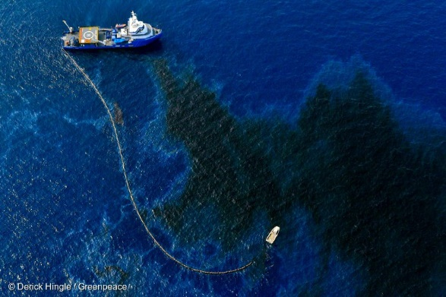
What is an Oil Spill?
Escape of oil into a body of water;
Causes can be natural or not;
Severe Consequences.

Slide 4

Website Features
Register and Login;
Profile;
Forum;
News Feed;
Vounteering;

Slide 5

Q&A

